Slide 1
Management of Immunotherapy‑Related Toxicities
Dr Fatima Aljojo M.D
Medical Oncology
An Oncologist At Al-Bairouni University Hospital

Slide 2
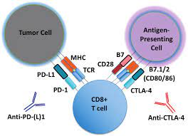
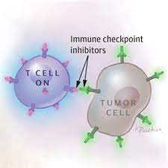
The Role of the Immune System in Cancer
Dynamic interactions take place between the immune system and cancer cells, whereby immune cells can detect genetic and cellular abnormalities present on cancer cells.
Various mechanisms are in place to closely regulate the activation and function of immune system effectors.

Slide 3
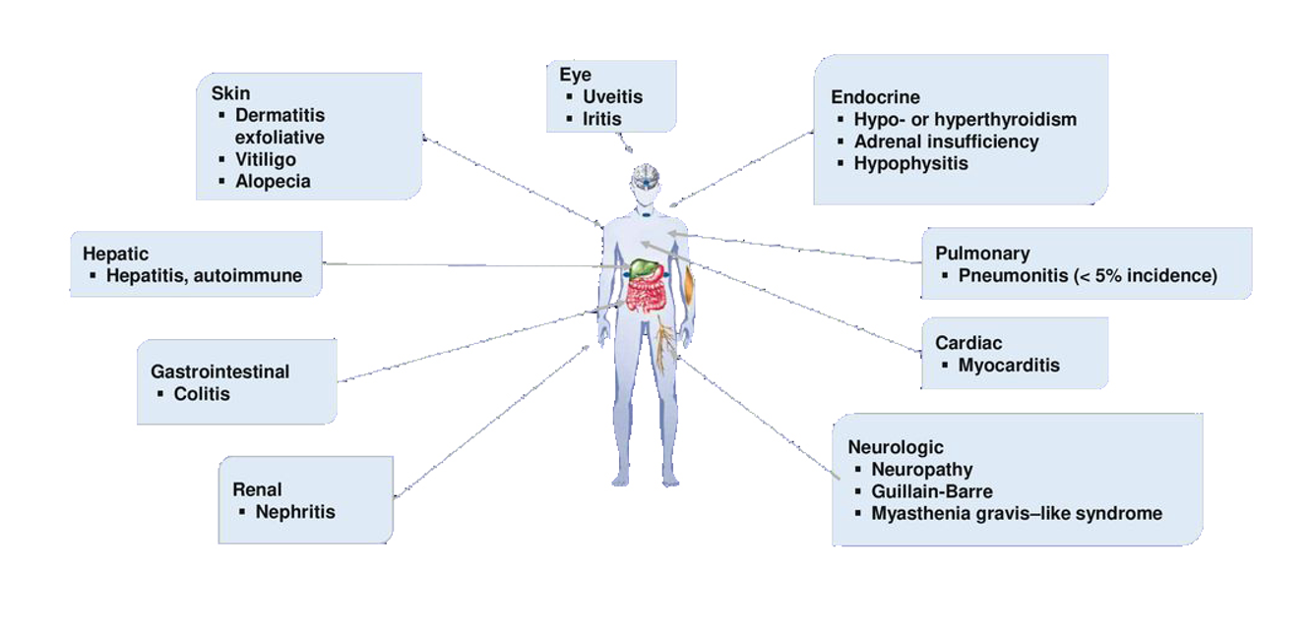
Management of Immunotherapy‑Related Toxicities

Slide 4
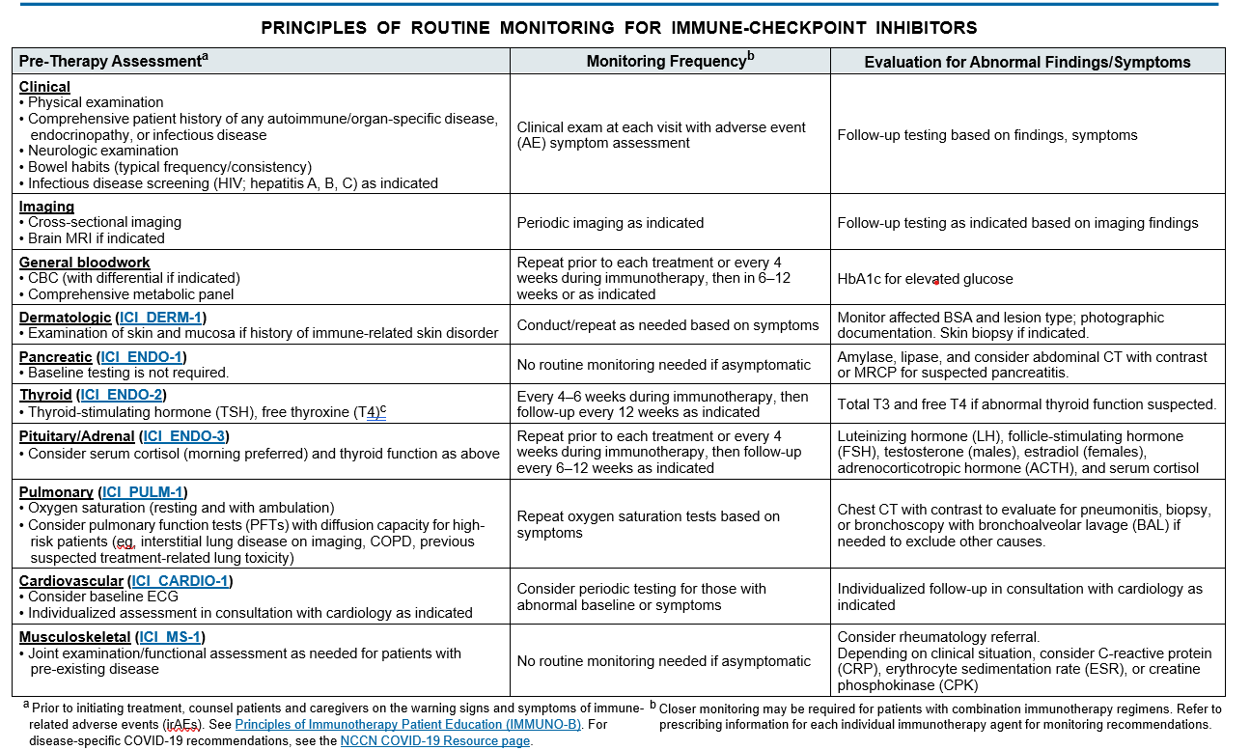

Slide 5
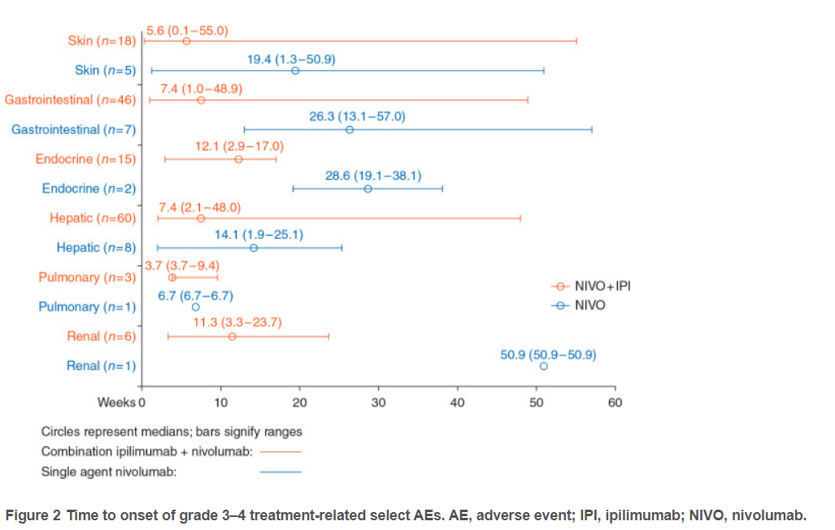

Slide 6
Immune-related endocrinopathies
Hyperglycemia
Workup negative for DKA
Continue immunotherapy
Monitor serial blood glucose with each dose
Diet and lifestyle modification if needed, medical therapy per institutional guidelines
Consider endocrine consultation

Slide 7
Immune-related endocrinopathies
Workup positive for DKA
Hold immunotherapy until DKA resolves
Inpatient care
Endocrine consultation
Management of DKA as per institutional guidelines
Insulin as directed by inpatient team and/or endocrinologist

Slide 8
Immune-related endocrinopathies
hypothyroidism
Asymptomatic/Subclinical hypothyroidism
Continue immunotherapy
Continue to monitor thyroid function tests (TFTs)
Clinical primary hypothyroidism
Monitor TSH every 4–6 weeks
Continue immunotherapy
Consider endocrine consultation
Initiate thyroid hormone supplementation with levothyroxine
Repeat TSH in 4–6 weeks to guide dosing changes.
Exclude concomitant adrenal insufficiency (morning cortisol level)

Slide 10
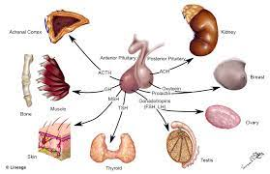
Hypophysis
4Morning cortisol and ACTH
4TSH, free T4
4LH, FSH, testosterone (men), estrogen (premenopausal women)
MRI brain ± contrast with pituitary
steroid replacement
4Central hypothyroidism (low TSH, low FT4)
thyroid hormone replacement
follow free T4 level for thyroid hormone dose titration

Slide 11
Gastrointestinal (GI) Toxicity
Diarrhea and colitis are the second-most commonly reported AEs with ICIs, and symptoms typically develop
within 6 to 8 weeks of starting treatment
Stool evaluation to rule out infectious etiology
4Nucleic acid amplification tests (NAATs) for GI
pathogens/bacterial culture
4C. Difficile
4Viral pathogens testing when available
4Based on institutional availability, consider lactoferrin/calprotectin
Infectious disease screening (HIV; hepatitis A, B, C) as clinically indicated
Consider abdominal/pelvic CT with contrast if G2–G4 colitis
Consider GI consultation if G2–G4
4Colonoscopy or flexible sigmoidoscopy± esophagogastroduodenoscopy (EGD) with biopsy

Slide 12
Gastrointestinal (GI) Toxicity
Corticosteroids are typically the first line of treatment for diarrhea.
However, a recent retrospective analysis of patients found higher infection rates among patients treated with long-duration steroids (>30 days).
Long-duration corticosteroid without infliximab was associated with increased infection risk compared to short-duration steroid plus infliximab, suggesting that earlier non-steroid immunosuppressive therapy may confer better outcomes.

Slide 13
Hepatic Toxicity
Hold immunotherapy
Initiate prednisone/methylprednisolone 1–2 mg/kg/day
Consider inpatient care
Monitor liver enzymes and LFTs every 2–3 days
Hepatology consultation
If steroid refractory or no improvement after 3 days, consider adding mycophenolate
Infliximab should not be used for hepatitis

Slide 14
Pancreatic Toxicity
Although rare, acute pancreatitis has been observed in patients, and radiologic features of immune-related pancreatitis have been described
Cases of recurrent pancreatitis have been reported upon resumption of PD-1 inhibitors.
Toxic effects on the endocrine pancreas, such as hyperglycemia and diabetes .
If there is no evidence clinical/radiologic evidence of pancreatitis and amylase/lipase levels improve, clinicians can consider resuming immunotherapy

Slide 15
Pneumonitis
These guidelines characterize mild pneumonitis (G1) as asymptomatic, confined to less than 25% of the lung parenchyma or a single lobe.
Moderate pneumonitis (G2) is characterized by the presence of new or worsening symptoms including shortness of breath, cough, chest pain, and fever.
Severe pneumonitis (G3) involves all lobes of the lung
Sputum culture (including bacterial, fungal, and acid-fast bacilli [AFB]) and blood culture
4Consider chest CT with contrast and repeat chest CT in 3–4 weeks

Slide 16
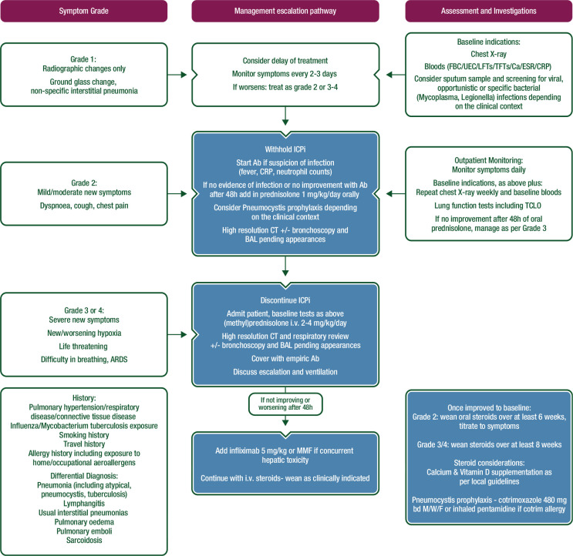

Slide 17
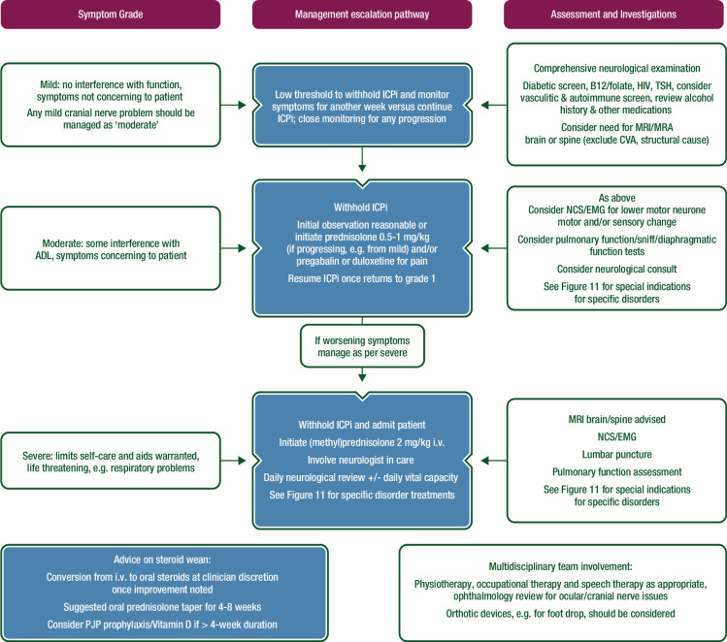

Slide 18
Elevated serum creatinine/acute kidney injury
Consider inpatient care
Follow urine protein/creatinine ratio every 3–7 days
Nephrology consultation
Consider renal biopsy if feasible prior to starting steroids
Prednisone/methylprednisolone 1–2 mg/kg/dayf
Consider adding one of the following if kidney injury remains >G2
after 4–6 weeks of steroids (in alphabetical order):
4Azathioprine
4Cyclophosphamide (monthly)
4Cyclosporine
4Infliximab
4Mycophenolate

Slide 19
Myocarditis symptoms are nonspecific.
It is rare, but potentially severe, not viral in etiology, associated with myositis/myasthenia gravis, and is more common with combination therapy.
In fatal cases, conduction abnormalities were mode of death and ejection fraction was preserved

Slide 20
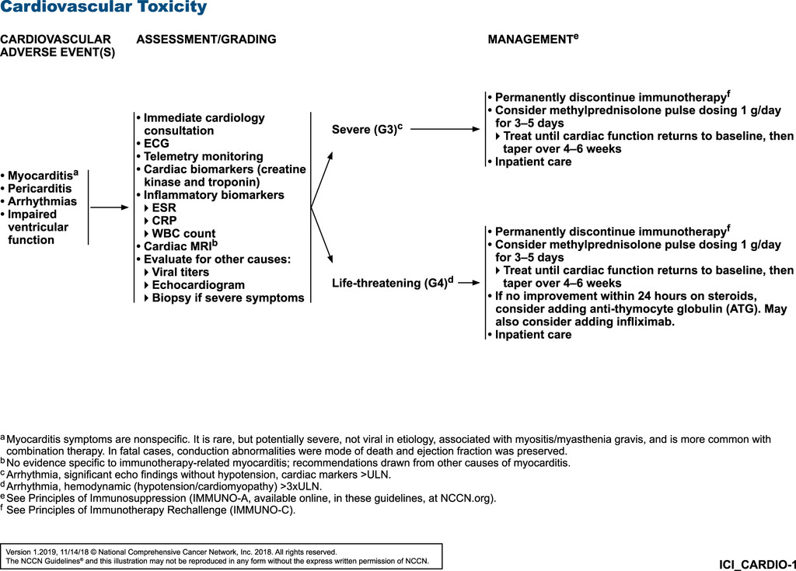

Slide 21
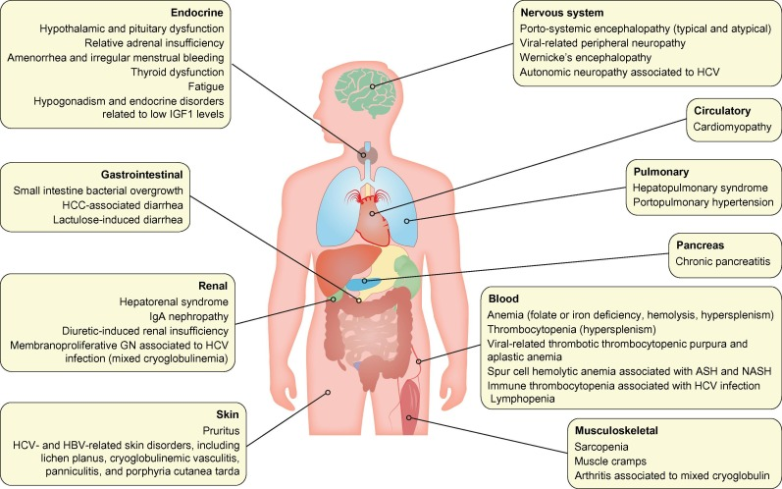
Management of Immune Relate Adverse Events (irAEs) in Cancer Immunotherapy
https://doi.org/10.1016/j.biopha.2019.109437

Slide 22
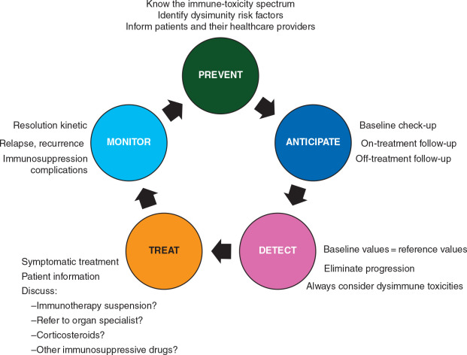
Management of Immunotherapy‑Related Toxicities

Slide 23
Thanks

